Slide 1



Educational for Drone
(eDrone)
Academy of Public Administration
Dulschi Silvia
eDrone
Educational for Drone (eDrone)
574090-EPP-1-2016-1-IT-EPPKA2-CBHE-JP
………...
This project has been funded with support from the European Commission. This publication (communication) reflects the views only of the author, and the Commission cannot be held responsible for any use which may be made of the information contained therein.

Slide 2
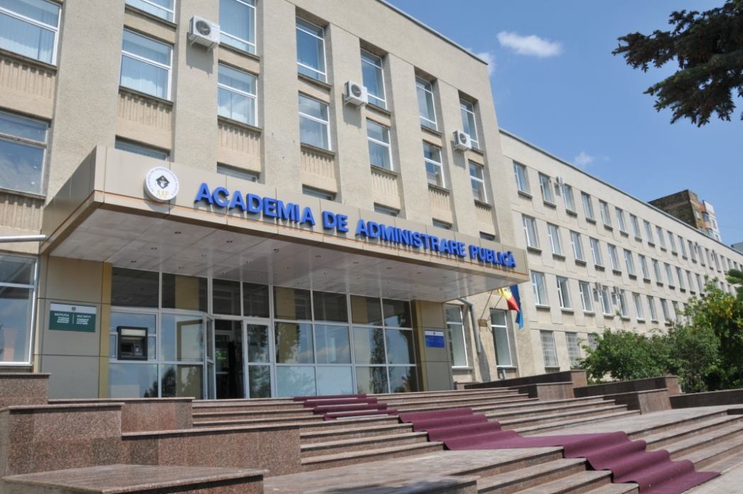
is a state institution of higher education which has the mission of training highly qualified specialists (master’s and doctoral degree - cycles II and III), further professional development of public service staff and scientific-methodical assurance of public authorities activities.
Academy of Public Administration
Academy of Public Administration was established by Presidential Decree no. 73 of 21 May 1993, with the initial status Academy of Studies in Public Administration.
Dulschi Silvia

Slide 3
Academy of Public Administration
Council for
Institutional Strategic Development
SENATE
Council of Administration
RECTOR
Prime-prorector
Prorector
Logistics General Department
International Relations Department
Higher Studies of Master Department
Scientific
Library
Professional Development Department
Production Department
(canteen)
Hostel
Planning and Accounting Department
Scientific Department
Chairs of instruction:
Administrative Sciences
Juridical Sciences
Economy and Public Management
Political Sciences and International R elations
Doctoral School in Administrative Sciences
Personnel Management and Public Relations Department
Edirorial Activity Department
Public Administration Journal

Slide 4

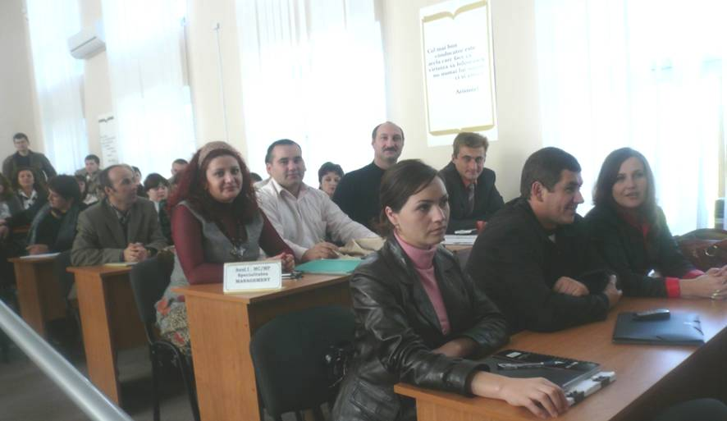
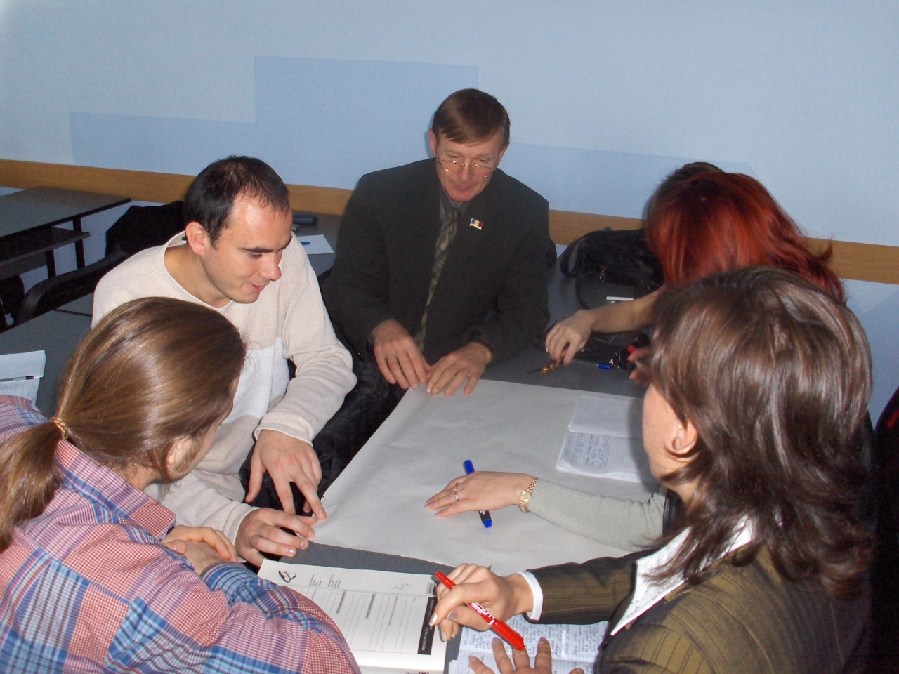
Academy of Public Administration
The Academy of Public Administration has the following levels of studies:
Professional Master’s degree
Research Master’s degree
PhD and Postdoctorate
Professional Development
Scientific Activity

Slide 5
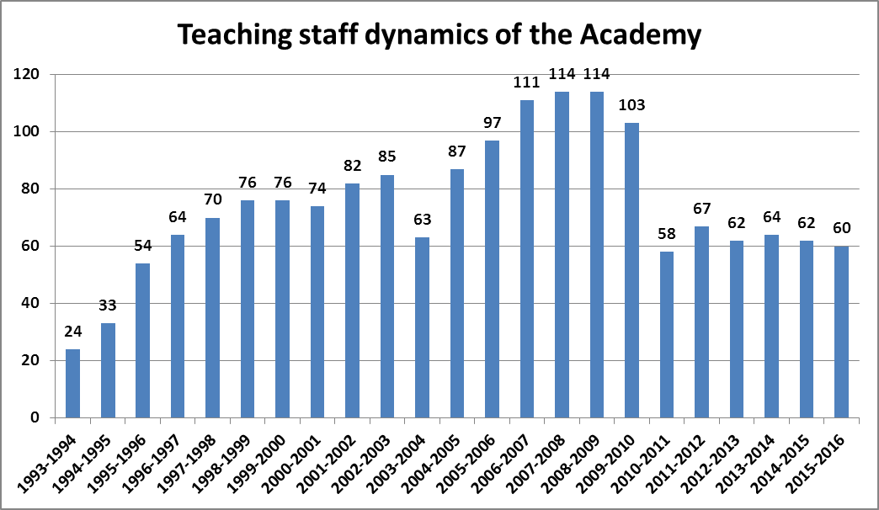
Academy of Public Administration
The professorial staff consists of 80 (2016-2017) well prepared
lecturers with scientific degree and research work
experience. In the framework of the Academy activates
professors and lecturers well known in the country.

Slide 6
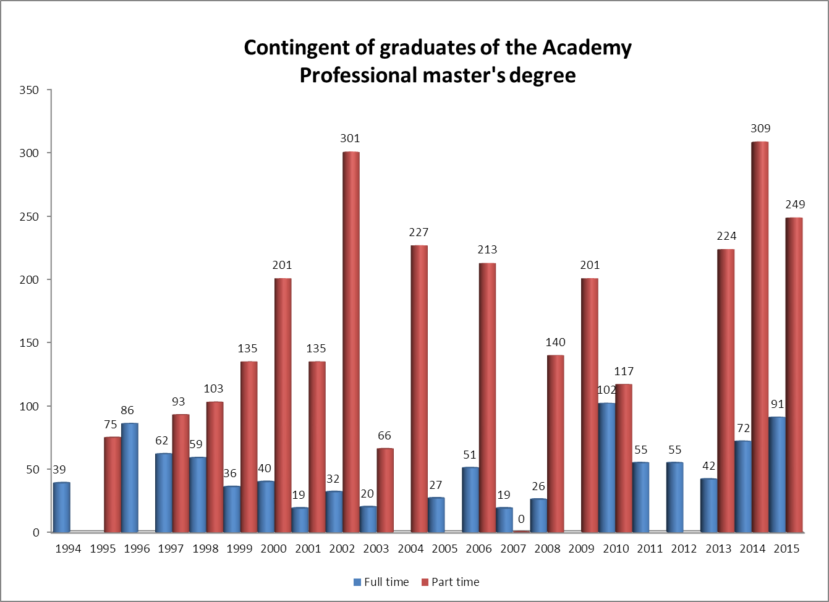
Academy of Public Administration
Full time
Part time

Slide 7
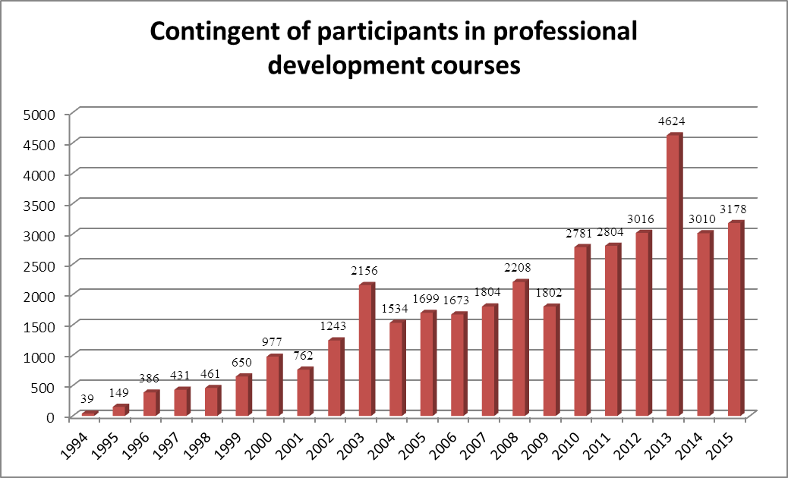
Academy of Public Administration

Slide 8
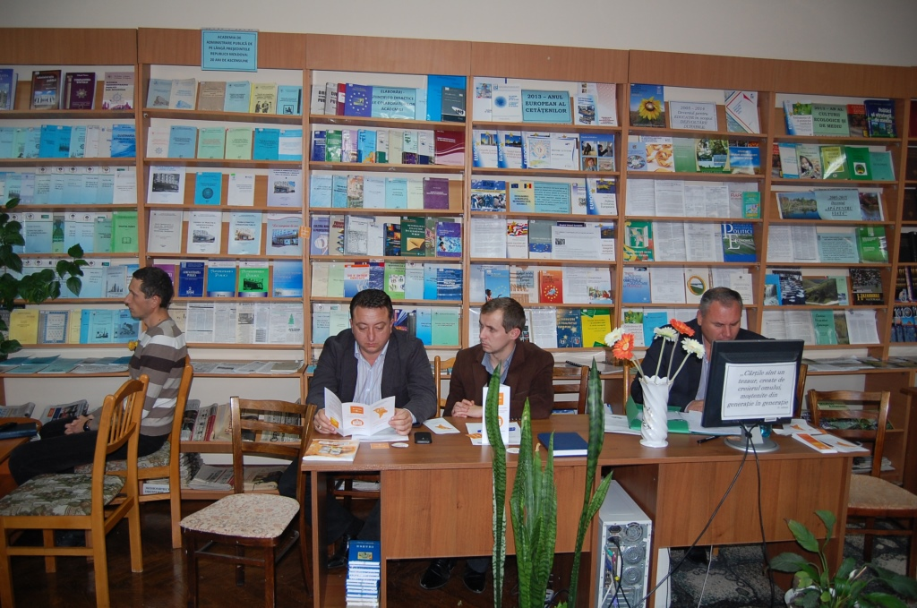
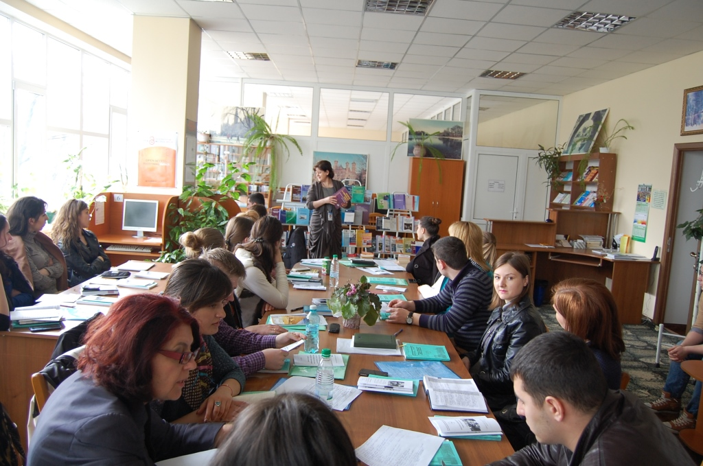
Academy’s Library
Academy of Public Administration
• collections of publications in order to support teaching and research process, including textbooks, monographs, treatises, periodicals and serials, reference publications, special collections - 39822 volumes (10609 titles);
• access to databases offered by EBSCO within the Consortium REM;
• online database (the Republic of Moldova legislation);
• electronic catalog OPAC (Online Public Access Catalog);
• information compartment on the website of the APA.

Slide 9
International Cooperation
Academy of Public Administration
Academy:
established and signed cooperation agreements with abroad similar institutions (Belarus, Bulgaria, Canada, France, Italy, Latvia, Lithuania, Poland, Portugal, Romania, USA, Sweden, Ukraine, etc.);
developed collaboration relations with international organizations, funds, networks and European programs.

Slide 10
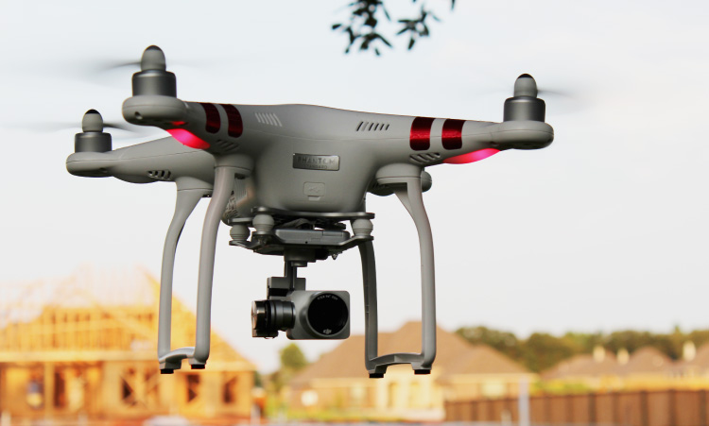

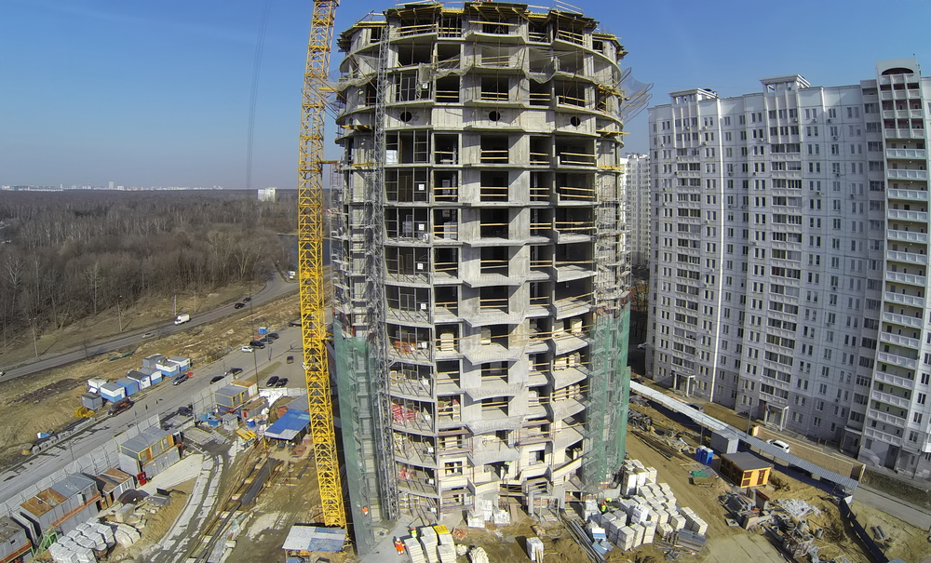

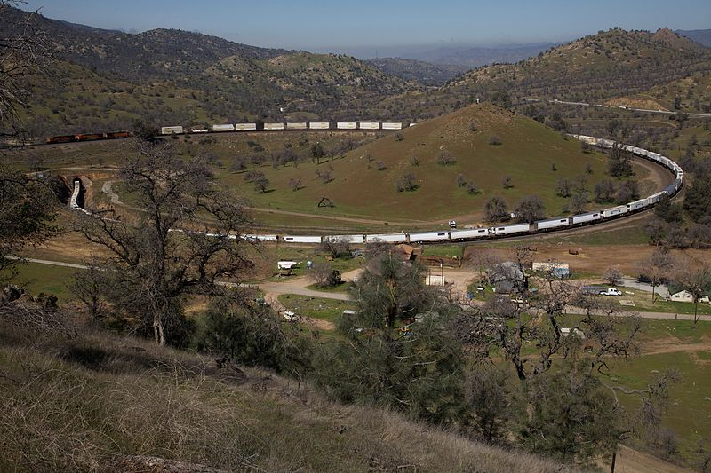
eDRONES - APA?
Courses for different categories of civil servants;
Contributing to the development of the legal framework on the use of drones.

Slide 11

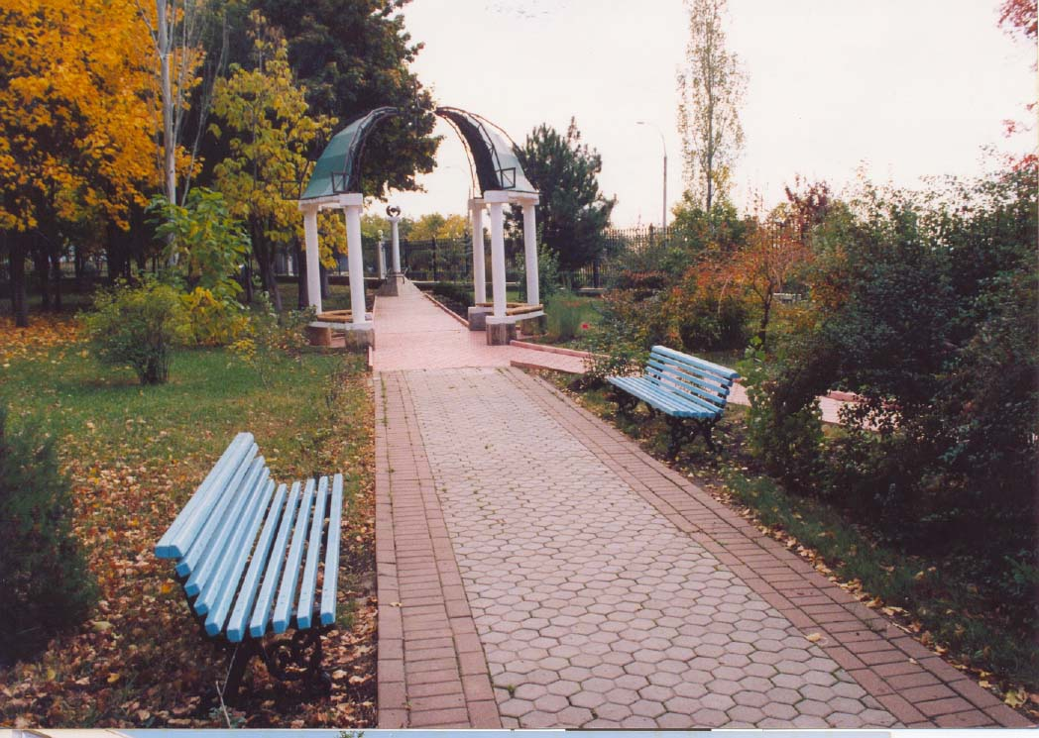
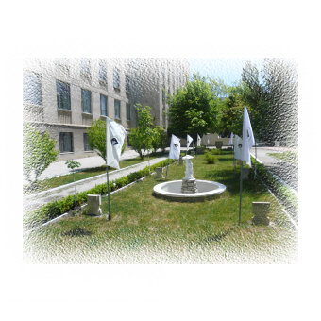
Academy of Public Administration
Contact us:
100, Ialoveni Street,
Chisinau, MD-2070
Republic of Moldova,
phone: (+373) 22 723830
phone/fax: (+373)22 284871
e-mail:aap@aap.gov.md
www.aap.gov.md

Slide 12
Thanks for your attention!
Dulschi Silvia

